Slide 1
Running Docker Apps in the AWS Cloud
Dominic Zarro (ADNET Systems, Inc.)
SESDA Data Center CIG
June 2018
Notes:
Click to add notes

Slide 2
Outline
Setting up an AWS EC2 instance
Running Docker
Running a Docker Python app
Distributing a Docker image

Slide 3
Setting up AWS EC2 instance
Apply for 12 month free-tier account:
https://aws.amazon.com/free
2. Create Elastic Compute Cloud (EC2) instance:
https://aws.amazon.com/ec2
Up to 750 hours per month of Linux (or Windows) server uptime with 1 GB memory
Up to 30 GB of permanent block storage
Up to15 GB of bandwidth

Slide 4
Docker
What is Docker?
Docker is a platform to develop, deploy, and run applications within containers:
https://docs.docker.com/get-started
What is a Docker Container?
A container is a running Docker image.
What is a Docker Image?
An image is an executable package that includes everything needed to run an application--the code, a runtime, libraries, environment variables, and configuration files.

Slide 5
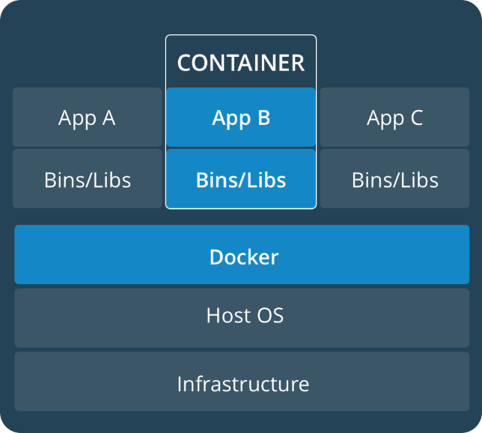
Docker Background
Why use Docker?
Flexible: Complex applications can be containerized.
Lightweight: Containers leverage and share the host kernel.
Portable: Build images locally, deploy to the cloud, and run anywhere.
Distributed: Access Docker Hub registry for pre-built and tested images: https://hub.docker.com
Export App
Local Host
Remote Host

Slide 6
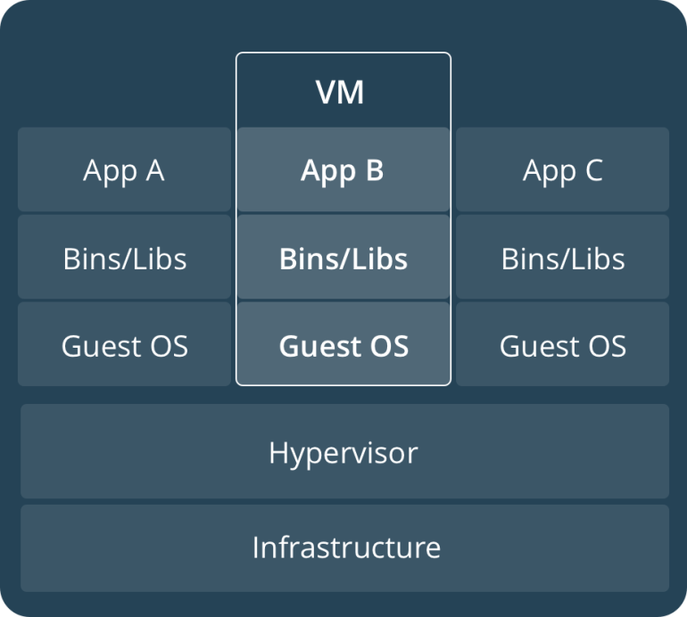
Docker Background
How does Docker differ from a virtual machine (VM)?
VM runs full-blown “guest” operating system with virtual access to host resources.
VM provides environment with more resources than most applications need.

Slide 7
Docker Example
Amazon Linux has Docker pre-installed
$ docker info
Containers: 42
Running: 0
Paused: 0
Stopped: 42
Images: 25
Server Version: 18.03.1-ce
Run Hello World (pre-built image from Docker Hub)
$ docker run hello-world
Unable to find image 'hello-world:latest' locally
latest: Pulling from library/hello-world
9bb5a5d4561a: Already exists
Digest: sha256:f5233545e43561214ca4891fd1157e1c3c563316ed8e237750d59bde73361e77
Status: Downloaded newer image for hello-world:latest
Hello from Docker!

Slide 8
Build a Docker Image
Create a Dockerfile (simple instruction text)
FROM python:3 # pull latest Python 3 image from Hub
CMD ["python"] # run this command when running image
Build Docker Image (in Dockerfile directory)
$ docker build –t python3 .
Sending build context to Docker daemon 8.192kB
Step 1/2 : FROM python:3
---> a5b7afcfdcc8
Step 2/2 : CMD [ "python"]
---> Running in e612cb3c4d5a
Removing intermediate container e612cb3c4d5a
---> 697d84845520
Successfully built 697d84845520
Successfully tagged python3:latest

Slide 9
Run Docker Image in Container
Verify image was created
$ docker images
REPOSITORY TAG IMAGE ID CREATED SIZE
python3 latest d4d98018e083 3 minutes ago 912MB
Run image in an interactive terminal container
$ docker run –it python3
Python 3.6.5 (default, Jun 6 2018, 19:19:24)
[GCC 6.3.0 20170516] on linux
Type "help", "copyright", "credits" or "license" for more information.
>>>
>> print("Hello World")
Hello World
>>>

Slide 10
Add Display Functionality to Image
Add Run command to Dockerfile to install Matplotlib in image
FROM python:3 # pull latest Python3 image from cache
RUN pip install matplotlib # install matplotlib
CMD ["python"] # run this command when running image
Re-build Python 3 image
$ docker build -t python3 .
Re-run image in container (need X-forwarding for DISPLAY)
$ docker run -it \
-v /tmp/.X11-unix \ # need these lines to forward X-display
-e DISPLAY \
python3

Slide 11
Plot Python Numpy Array
Python 3.6.5 (default, Jun 6 2018, 19:19:24)
[GCC 6.3.0 20170516] on linux
Type "help", "copyright", "credits" or "license" for more information.
>>>
>>> import matplotlib.pyplot as plt
>>> import numpy as np
>>> x=np.arange(0.0, 5.0, 0.1)
>>> y=np.cos(x*np.pi)
>>> plt.plot(x,y)
>>> plt.show()

Slide 12
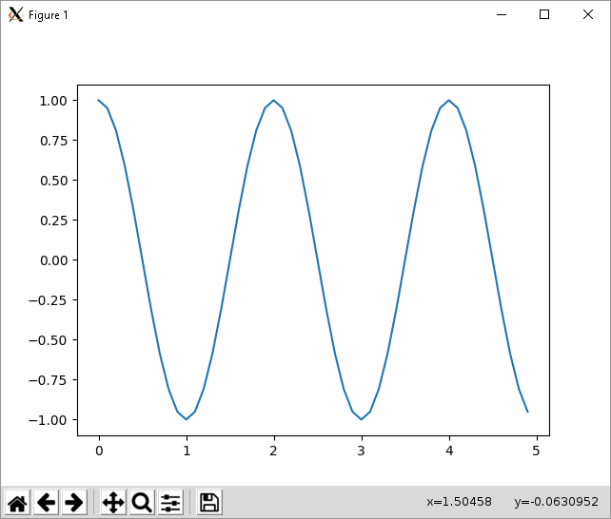

Slide 13
Run External Python Function
Mount local directory as external disk volume
$ docker run -it \
-v ${PWD}:/home/python # mount current directory inside container
-v /tmp/.X11-unix \
-e DISPLAY \
python3
Import Python library module from local directory
Python 3.6.5 (default, Jun 6 2018, 19:19:24)
[GCC 6.3.0 20170516] on linux
Type "help", "copyright", "credits" or "license" for more information.
>>>
>>> import myplot
>>> myplot.run()

Slide 14
Distribute a Docker Image
Set up account on DockerHub:
https://hub.docker.com
Log into DockerHub:
$ docker login
Tag image with username:
$ docker tag python3 dzarro/python3
Push image to DockerHub:
$ docker push dzarro/python3
Pull image to new host:
$ docker pull dzarro/python3

